Slide 1


LibreOffice WebAssembly (LOWA )
An Introduction
Svante Schubert <svante.schubert.extern@allotropia.de>
PDF en español
by deepl.com
ODP en español
by deepl.com
Notes:
Freelancer from Berlin
Friend of Thorsten Behrens – CEO of allotropia
2 weeks ago asked to join the conference
It is a carrot and stick to learn Spanish again!
Love to be here!

Slide 2
Congreso Latinoamericano, 2023-11-10
Who’s talking?
Svante Schubert – ex-StarDivision (started 1999 in Hamburg)
  OASIS ODF TC: co-chair, co-editor
  ODF Toolkit co-maintainer
  ODF2XHTML XSLT filter
Notes:
Who am I
- Freelancer from Berlin
- ODF2XHTML is a sin of my past,
The Transformation is being used to make the ODF specification (ODT) accessible for the Web.
It is not possible to jump into a document when opening it, like HTML does.
Every MIME Type can have a fragment identifier (this hash #) but we have not define it, yet!
For spreadsheet: Point to a formula, some cells
For presentation: a certain slide
For text documents: To a paragraph, or even text selection..

Slide 3
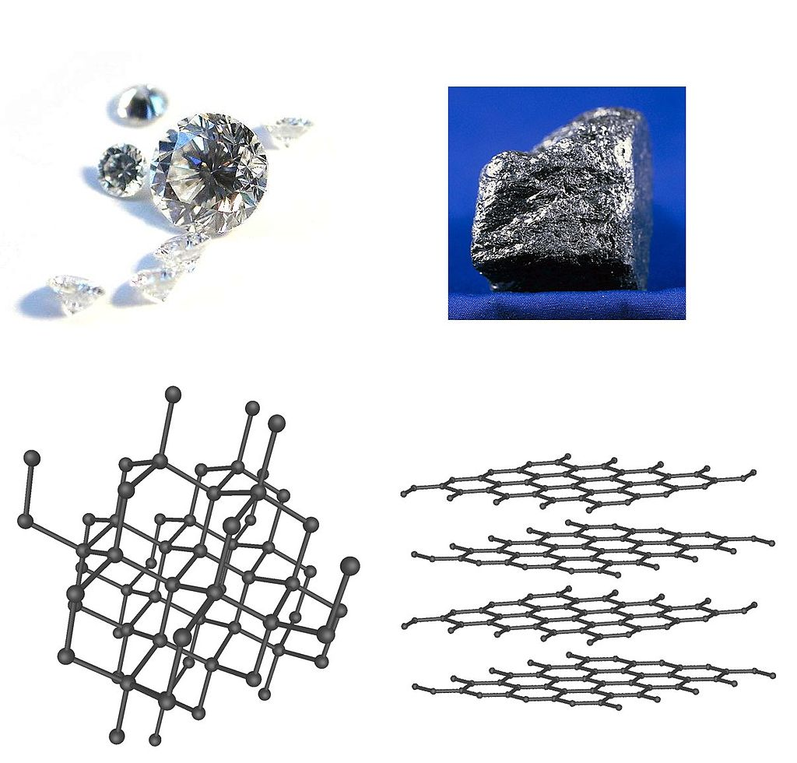
allotropia
An allotrop of an chemical element
is existing in multiple forms in the same physical state.
Diamond and graphite
are two allotropes of carbon
(from Ancient Greek
ἄλλος (allos) 'other',
and τρόπος (tropos) 'manner, form')
Notes:
- The suffix sounded more appropriate!

Slide 4
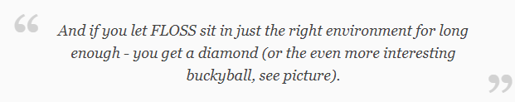
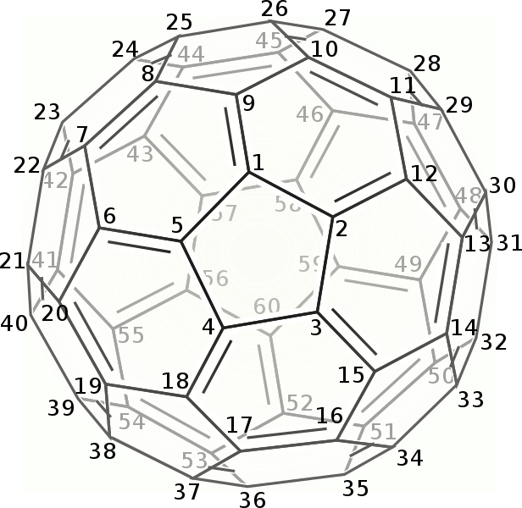
allotropia
https://en.wikipedia.org/wiki/Buckminsterfullerene (aka buckyball - formula C60)
Notes:
Diamant or Buckyball (C60)
FLOSS (Free/Libre and Open Source Software)

Slide 5
allotropia
German company from Hamburg
by Thorsten Behrens
(CEO of allotropia & TDF Board chairperson)
Professional LibreOffice support for Governments and Enterprises
Being a huge ODF supporter:
  Michael Stahl (allotropia)
  being co-editor in the OASIS ODF TC
  Michael Stahl (allotropia)
  being co-maintainer of the ODF Toolkit (used for ODF validator)
Notes:
allotropia assists usage of LibreOffice as a professional level (like for Enterprises or Governments)
Very similar to Collabora, just the core team is from Germany!
allotropia supports the ODF
- Michael Stahl (a writer specialist) is ODF TC - co-editor
- Michael Stahl (co-maintainer of ODF Toolkit)

Slide 6
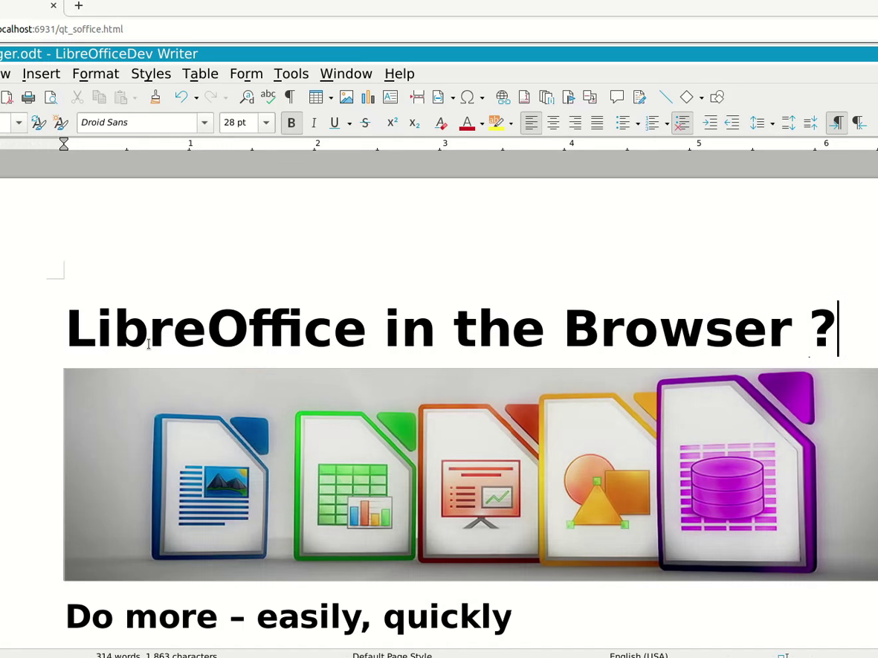



What?
LibreOffice WebAssembly (LOWA)
Native port of LibreOffice, running client-side in the browser
Project was funded by NLnet / Horizon 2020 (EC), allotropia software GmbH (inventors of LOWA);
used by Collabora Productivity
Notes:
Native port:
C++, cross-compiled via emscripten
Using WASM / W3C since 2019
A port in computer software is when a piece of software has been translated or converted to run on different hardware or operating system (OS) than it was originally designed for

Slide 7
Why WebAsembly?
Notes:
* the browser is the new OS - with a ton of innovation & progress
* latency, scalability and E2E encryption require browser-local solution
* WASM as technology is now ready for main stream
* e.g. AutoCAD and a load of FLOSS projects got ported in the past years
* LibreOffice per se very portable (desktop OSs, mobile, Online)
* no self-hostable Office 365
* US jurisdiction bleeds into your business - the digital sovereignity question
* complex, brittle & risky to integrate with hyperscalers
also, lots of line of business applications are migrating now!

Slide 8
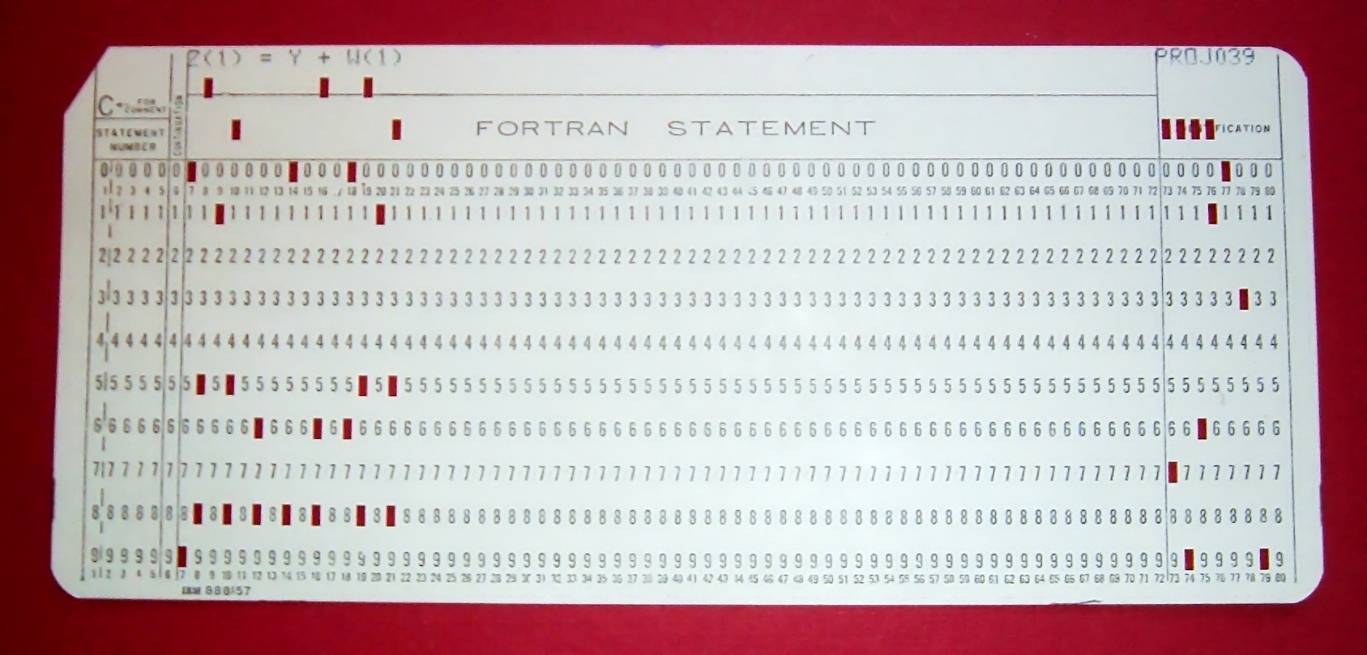
Programming
Punch Cards till ~1975
Write once
80 characters per card
Program = deck of cards
How many cards LO code?
~10 million lines of code
(don’t drop THAT box!)
Notes:
=> LO: around 10M LoC, but with 3rd party libs

Slide 9
From Text Editor to Machine
Software Programs in their most distinc forms:
Source Code of Programmer:
High level semantic text file
in a Programming Language
Machine Code for CPU/GPU:
Low level semantic binary file
with commands to the machine
Notes:
There are TWO opposite SIDES:
INBETWEEN can happen a lot!
HOW do you get from ONE side to the OTHER?

Slide 10
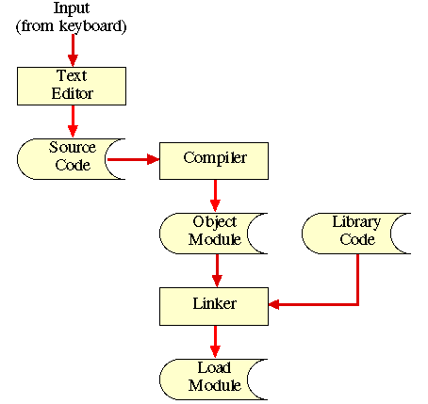
Source Code to
Executable Program
Semantically high-level
Source Code in text files of
Programming Language
Ahead-Of-Time (AOT) Compiler
transforming the Source Code
into Machine Code (Object Module)
of a Machine Language
Object Module is
Machine Code to run on
Computer Architecture (e.g. x64)
build depends on
Operating System (e.g. Linux)
due different Calling Conventions
From THE MECHANICS OF CREATING AN EXECUTABLE COMPUTER PROGRAM
Notes:
Our LibreOffice C++ code is being compiled (transformed) into binary code, which one explicitly on a specific
---------------
=> Computer Architecture (CPU commands)
---------------
=> OS – with different calling options:
https://en.wikipedia.org/wiki/Calling_convention
=> The order in which parameters are passed. Options include left-to-right order, or right-to-left, or something more complex.

Slide 11
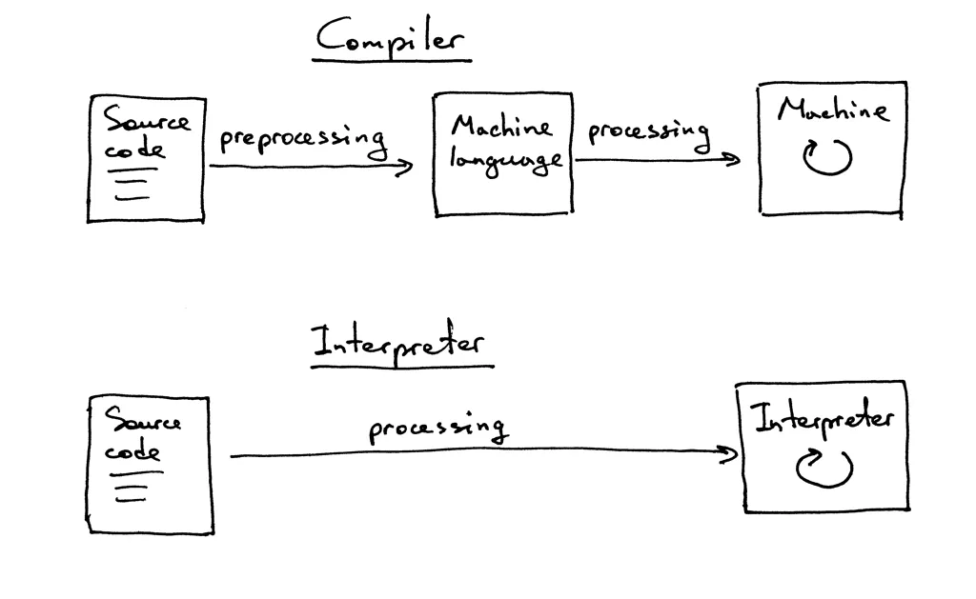
Compiler vs.
Interpreter
Compiler == Translator at Buildtime
PRO:
  Faster at RunTime!
Interpreter == Translator at Runtime
PRO:
  Code runs on multiple Platforms!
  Code still can be read!
From https://medium.com/@Sujithnath/angular-aot-vs-jit-comparison-ce1d96ede491
Notes:
=> AOT: Translate ONCE (for each platform) and run multiple time!
(e.g. C++ used for LIBREOFFICE)
=> JIT: Translate all the time the same Code!
(e.g. JavaScript in the Browser)

Slide 12

Problem: Tower of Babel
Thousands of Programming Languages
  Each in different versions
Hundreds of Computer Architecture
each with an own machine language due to:
  Different CPU register size: 32bit, 64bit,..
  New CPU versions with new commands
  e.g. SIMD Single Instruction Multiple Data
  (used to parse JavaScript extreme fast)
https://en.wikipedia.org/wiki/Comparison_of_instruction_set_architectures (Computer Architecture)
https://en.wikipedia.org/wiki/Comparison_of_programming_languages (Programming Languages)
Notes:
* How many Programming languages do exist?
=> According to the Online Historical Encyclopaedia of Programming Languages, people have created about 8,945 coding languages. Today, various sources report anywhere from 250-2,500 coding languages, although far fewer rank as top contenders in the commonly used group.
* How many Computer Architecture do exist?
=> Hundreds?
=> 32bit or 64bit (register -
https://www.utd.hs-rm.de/infobuch2/buch_webseite/kap03/assemblerbefehle.pdf

Slide 13
Problem: Tower of Babel
1000 Programming
Languages
*
100 Computer Architecture
=>
100.000 Compilers (?)
https://en.wikipedia.org/wiki/Comparison_of_instruction_set_architectures (Computer Architecture)
https://en.wikipedia.org/wiki/Comparison_of_programming_languages (Programming Languages)
Notes:
* How many Programming languages do exist?
=> According to the Online Historical Encyclopaedia of Programming Languages, people have created about 8,945 coding languages. Today, various sources report anywhere from 250-2,500 coding languages, although far fewer rank as top contenders in the commonly used group.
* How many Computer Architecture do exist?
=> Hundreds?
=> 32bit or 64bit (register -
https://www.utd.hs-rm.de/infobuch2/buch_webseite/kap03/assemblerbefehle.pdf

Slide 14

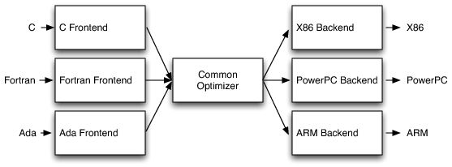
Solution: LLVM
LLVM
1000 Programming Languages
+
100 Computer Architecture
=>
1000 Frontends
and
100 Backends
https://aosabook.org/en/v1/llvm.html - Architecture diagram by Chris Lattner (co-inventor LLVM)
)
https://en.wikipedia.org/wiki/LLVM - Low Level Virtual Machine
Notes:
* Aside Reusage Compiler Technology
* By Chris Lattner who worked for Apple and invented later the Programming Langugae SWIFT

Slide 15
Solution: Emscripten
(LLVM/Clang based Compiler)
Creates Webassembly/WASM
In binary format
In text format
Or asm.js (JS subset) being once one of the origins of WASM
C
Webassembly
(Binary Code)
LLVM fontends (*) e.g. RUST
Emscripten
Webassemby
(Text)
C++
asm.js
(JS subset)
(*) All LLVM supported Programming Languages can be compiled to WebAssembly
(not directly by WebAssemblY)
https://en.wikipedia.org/wiki/Emscripten - Emscripten
Notes:
* To enable WebAssembly to be read and edited by humans, there is a textual representation of the Wasm binary format.
* NOTE: All LLVM inputs fpr Webassembly but not necessary with Emscripten

Slide 16
Solution: Webassembly
Designed/Steered
by W3C
From asm.js (by Mozilla)
From NaCl (by Google)
(Native Client)
Supported by Microsoft and Apple
Bundled with browsers
C
Webassembly
(Binary Code)
LLVM fontends (*), e.g. RUST
Emscripten
Webassemby
(Text)
C++
asm.js
(JS subset)
(*) All LLVM supported Programming Languages can be compiled to WebAssembly
(not directly by WebAssembly)
(*) All LLVM supported Programming Languages can be compiled to WebAssembly
(not directly by WebAssemblY)
https://en.wikipedia.org/wiki/Emscripten - Emscripten
Notes:
* To enable WebAssembly to be read and edited by humans, there is a textual representation of the Wasm binary format.

Slide 17
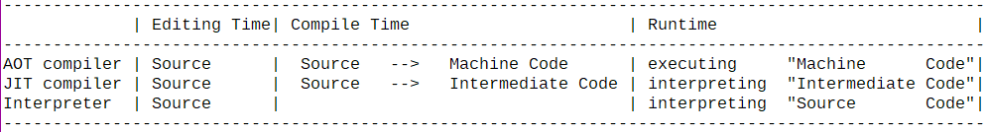
Compiler:
AOT, JIT and Interpreter
Ahead of Time (AOT) – compile once ahead
Just in Time (JIT) – compile every time on execution
NOTE:
Mixform exist where "interpreting" is also the “compiling” of HotSpots!
Notes:
=> NEXT SLIDE: The interpreter is in every browser

Slide 18
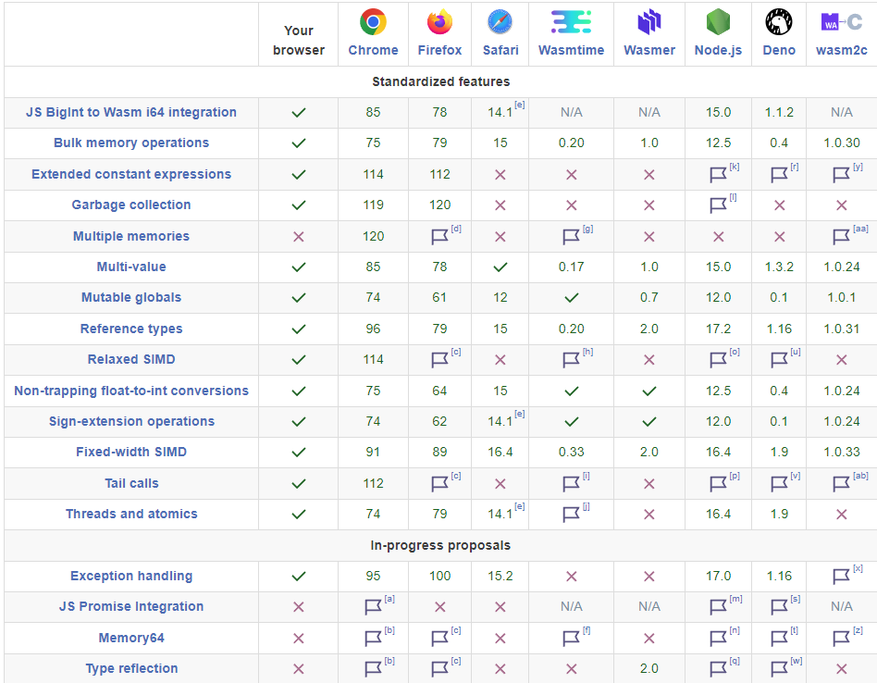
WebAssembly Roadmap
Bundled Interpreter
Green number =
version number since feature
is enabled
Flag =
requires a compile flag
(available in Nightly build
not beta or release)
Red cross =
not supported
Your browser =
my browser:
Chrome Ver. 119.0.6045.124
https://webassembly.org/roadmap/ - WebAssembly Roadmap
Notes:
WASM interpreter
bundled in Browser and virtual Machines

Slide 19
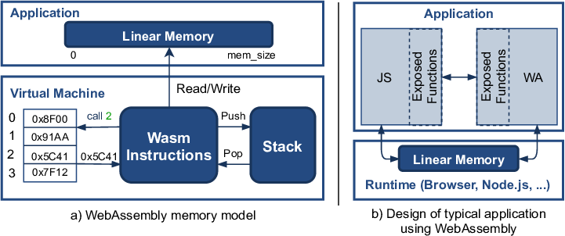
WebAssembly
Design & Interoperablity
Webassembly Code works with existing JavaScript Code
From Wasmati: An Efficient Static Vulnerability Scanner for WebAssembly

Slide 20
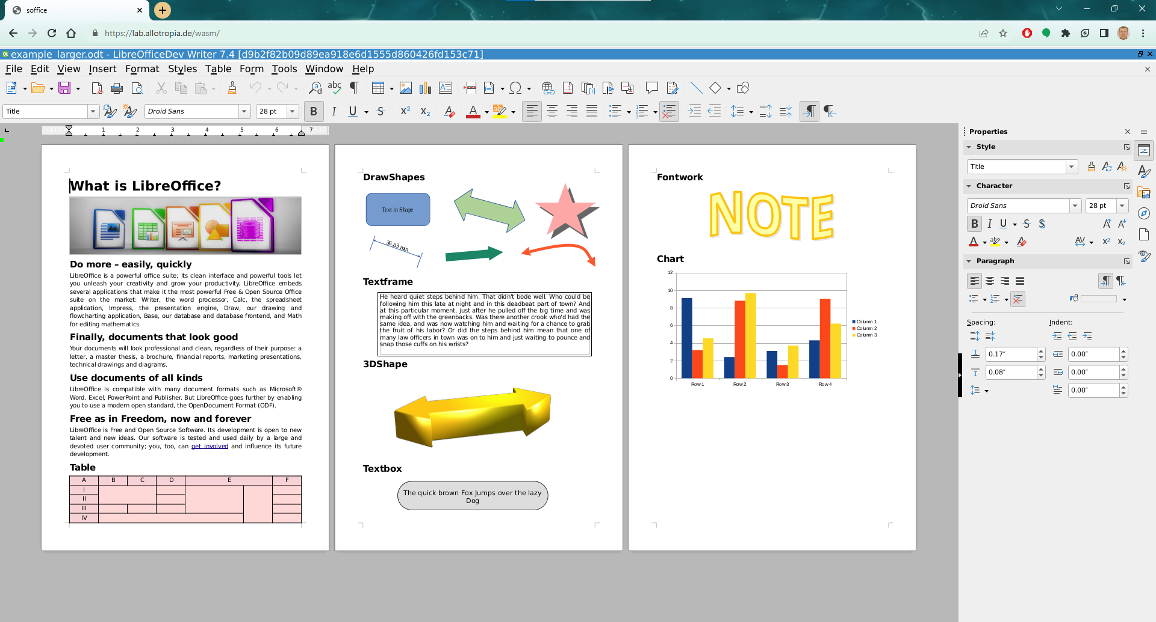
LOWA https://lab.allotropia.de/wasm
Notes:
- Resize slow
- latest Build should allow loading own ODT

Slide 21
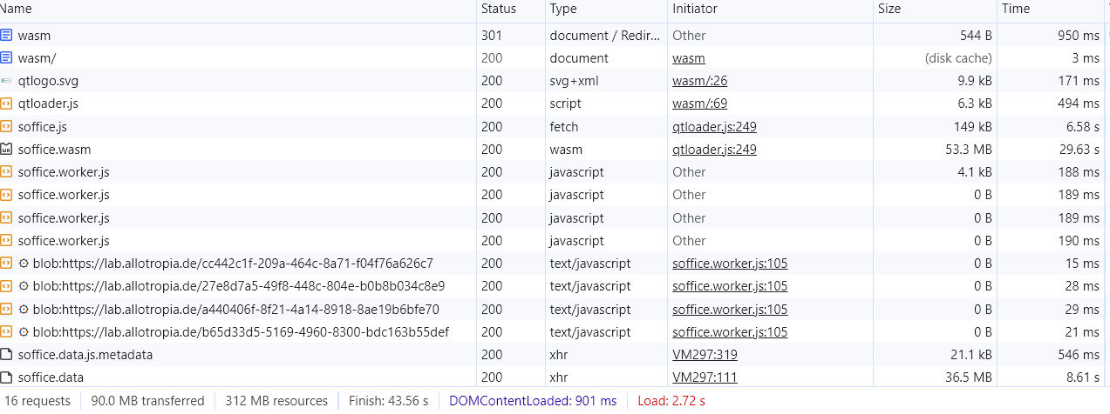
LOWA loading time: @hotel-Wifi)
Loading - https://lab.allotropia.de/wasm
with Chrome Ver. 119.0.6045.124 – 43,5 sec (see above) with FireFox 119 – 7min 16 sec
Notes:
At our hotel in Mexico City it was 8 seconds.
Instead of downloading the office for every usage, why not having an extension?
a) Google Dev Tools (open by pressing F12)
b) FireFox
- deleted cache
- started recording Websession
- Profile opened automatically

Slide 22
LOWA Advantages
No duplication of Implementation (1 Codebase)
Office deployment as easy as loading JavaScript (later Browser Cache)
LOWA runs in all WASM platforms (browsers)
Reuse of Web Libraries (e.g. encryption)
Need of modularization for LOWA will increase scalability (e.g. for stand-alone Converters)

Slide 23
Evolution of
Office Collaboration
Exchanging paper
  One user can view/edit the document
  No computer involved (no digitalization)
Exchanging digital documents
  One user can view/edit the document
  No advantage over text files

Slide 24
Evolution of
Office Collaboration
Exchanging office documents (change tracking)
  One user can view/edit the document
  Changes can be easily be viewed and accepted/rejected
  But accepting/rejecting changes is not being tracked
  In ODF XML & OOXML only the “previous state” is saved (no overlapping changes trackable)
  Changes are not defined for Change-Tracking
  (e.g. insert column)

Slide 25
Evolution of
Office Collaboration
Sharing same program and the same computer
  Multiple user can view/edit the document at the same time online
Sharing copies of the same document
  Multiple user can view/edit the document at the same time offline
  ODF Changes being exchanged and merged (like GIT)
Notes:
4) Sharing same program on the same computer (sharing computer)
- like playing strategy Computer games in 80ths - "Hot Seat"…
- Warlords2 (we switched the user
- LibreOffice Online (ACROS??)
5) collaborating via document copies
(GIT using semantic changes)
- Browser have DOM API for JavaScript
- No ODF API
(every office has its ownmacros)
(you might go offline - as you might merge changes like software patches)
6) Most important question of collaboration is:
WHAT HAVE YOU CHANGED!
No ODF changes defined

Slide 26
Stairway to
Office Collaboration
We need an OASIS ODF API, similar to W3C DOM API but on semantic level – insertColumn(..)
  What ODF XML bundles to “ODF Features”, e.g. Table
  What Changes does the user expect, e.g. insertColumn(..)
LO requires refactoring (as for WASM & ODF API)
OASIS ODF Standard
  Only knows XML no features such as a table
  Requires digitalization - generate software from spec
    Lower the burden for new implementors

Slide 27
LOWA Challenges

Slide 28
Early WASM Challenges
Maturity of platform (emscripten/WASM/browsers) unclear
Size of the problem …
Multi-threading & GUI event handling peculiarities
Heap size tops out at 4GB, because of WASM32 32bit pointers
Development / Debugging environments still very “fresh”
Notes:
maturity
we tried it in 2015 – not even got c++ exceptions to work
size of the problem
>10M LoC
>100 3rd party libraries & artefacts
notorious to break tool chains (“..breaking your tools since 1990..”)
size of the resulting WASM binary – makes browsers capsize hard
download size (also affecting cache-ability)”

Slide 29
LOWA Challenges
Size of the resulting WASM binary
  Currently: packed = 35M, optimised = 150M, debug = 200M + ~1G separate DWARF info
Size of the filesystem image
  ~ 100M with all LO fonts, can be stored locally and split if needed
  → less downloads on updates
  → can use webfonts
Embeddability & Programmability
  you want to use this from your JS framework
  massively powerful API (“UNO API”), how to bind that
Notes:
Loadable in the office

Slide 30
Core ideas
Build & GUI
LibreOffice is an autotools & GNU make project
  stick to that, avoid other parallel build systems
  and its already pretty portable, cross-compilation is supported out of the box
LibreOffice has its own GUI abstraction
  with plugins for Gtk, Qt/KF5, Win32 and OSX
  with Qt5 supporting WASM natively, we went with that

Slide 31
Core ideas
Build & GUI
LibreOffice is basically C++ (by and large c++17)
  we went with emscripten as platform compiler (pinned to 2.0.31 currently)
We don’t want to use any experimental WASM features
  no threading (but now full feature!)
  no dynamic linking (sadly require a re-tooling of the build system)
  no native WASM exceptions
We wanted to focus on Writer initially (and save size by not building/shipping the rest)

Slide 32
What to expect
(and our vision for LOWA)
Not a replacement for desktop/mobile LibreOffice, or Collabora Online
Instead serving unmet needs
Want to play yourself?
https://lab.allotropia.de/wasm
NOTE: at this time not the latest build deployed – build your own! :-)
Notes:
instead serving unmet needs:
provide offline capabilities for Collabora Online, on the client side
your platform is the browser? here’s your everything-works text widget!
require privacy-by-default, or end2end encryption? here’s your no-data-ever-goes-to-any-server solution!
want planetary-scale for your product, but lack GAFAM’s number of data centers? here’s something that scales like a static website!

Slide 33
Current LOWA status
https://wiki.documentfoundation.org/Development/WASM
  boils down to: use master, read static/README.wasm.md
Branch with extra features:https://git.libreoffice.org/core/+/refs/heads/feature/wasm
Master can now build and run:
  A WASM soffice.(html|wasm)*
  Calc and/or Writer, mostly working*
  A headless PDF converter
  An offline WASM plugin for Collabora Online

Slide 34

Questions & Answers

